Slide 1
Conventions & Notations
Suleyman Demirel University
CSS634: Deep Learning
PhD Abay Nussipbekov

Slide 2

Scalar
Rank-0 tensor
$x∈ℝ$
Example: $x=1$

Slide 3


Vector
Rank-1 tensor
$x∈ℝ^{n}$
$x∈ℝ^{n×1}$
Example: $x=\left[\begin{matrix}x_{1} \\ \begin{matrix}x_{2} \\ ⋮\end{matrix} \\ x_{n}\end{matrix}\right]$
$x^{T}=\left[\begin{matrix}x_{1} & \begin{matrix}x_{2} & ⋯\end{matrix} & x_{n}\end{matrix}\right]$, where $x^{T}∈ℝ^{1×n}$
Sometimes $D$ or $m$
You will see column representation often

Slide 4


Matrix
Rank-2 tensor
$X∈ℝ^{m×n}$
$x∈ℝ^{n×1}$
Example: $X=\left[\begin{matrix}x_{1,1} & ⋯ & x_{1,n} \\ ⋮ & ⋱ & ⋮ \\ x_{m,1} & ⋯ & x_{m,n}\end{matrix}\right]$
In many literatures $n$stands for number of examples so the shape of matrix (design matrix) is $X∈ℝ^{n×m}$
In $x_{i} t$he subscript $i$ denotes $i^{th}$feature
Sometimes $D$ or $m$
You will see column representation often

Slide 5
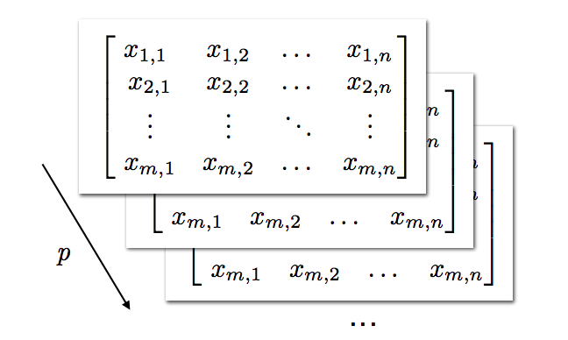

Tensor
A tensor is a generalization of vectors and matrices and is easily understood as a multidimensional array.
In the general case, an array of numbers arranged on a regular grid with a variable number of axes is known as a tensor
Rank-3 tensor
$X∈ℝ^{m×n×p}$

Slide 6
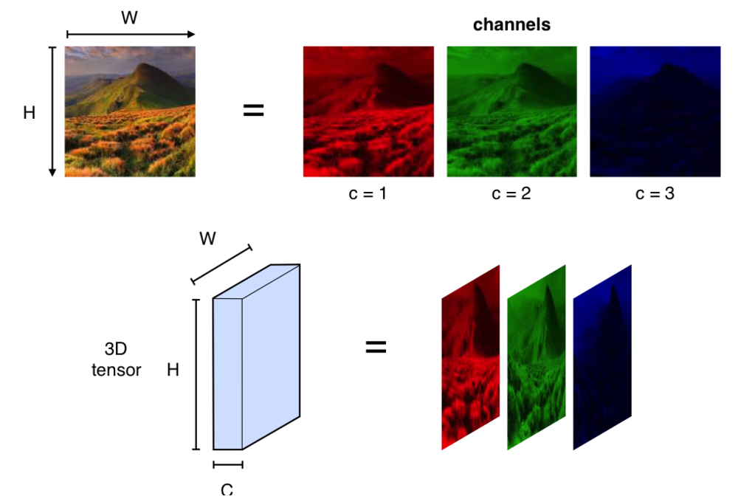
3D Tensor

Slide 7
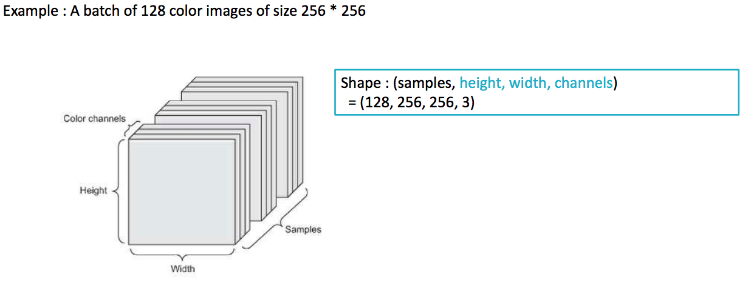
4D Tensor

Slide 8
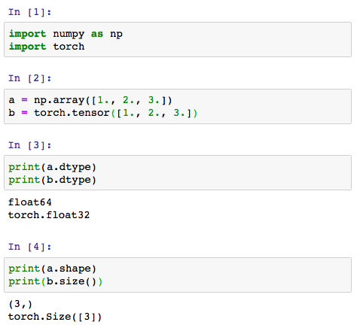
Multidimensional Arrays as Tensors

Slide 9
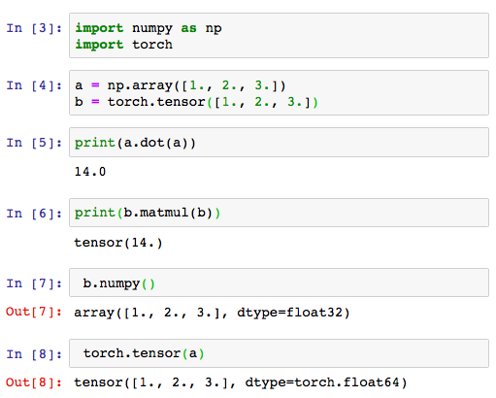
NumPy vs. PyTorch
“dot” vs “matmul”
We can convert, but pay attention to default types

Slide 10
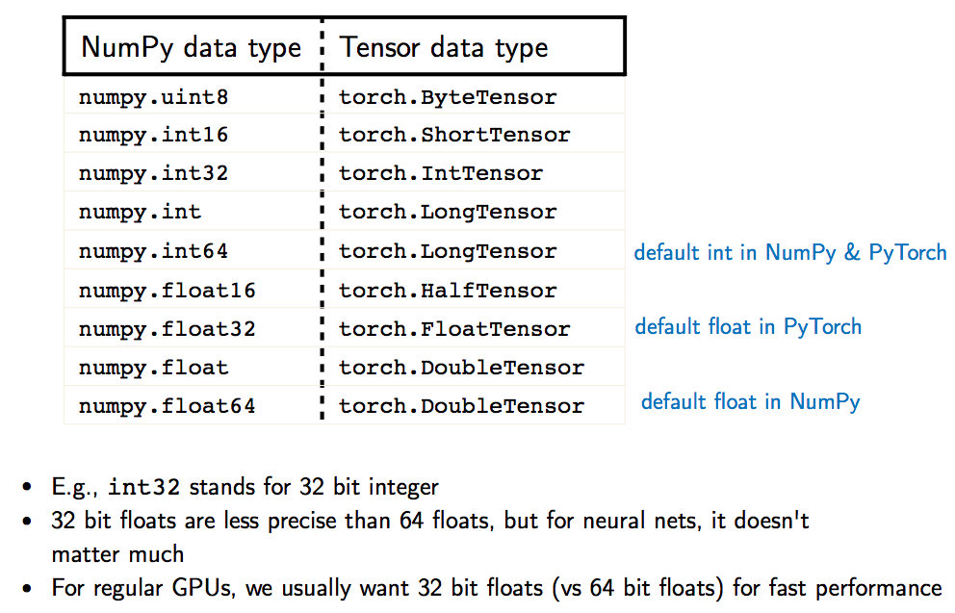
Data Types to Memorize

Slide 11
Why Not Just NumPy?
PyTorch has GPU support:
A. we can load the dataset and model parameters into GPU memory
B. on the GPU we then have better parallelism for computing (many) matrix multiplications
Also, PyTorch has automatic differentiation (more later)
Moreover, PyTorch implements many DL convenience functions (more later)

Slide 12
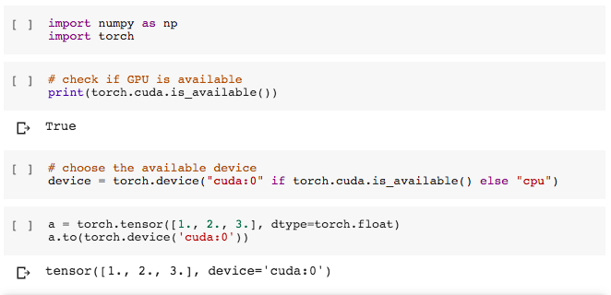
Loading Data onto the GPU

Slide 13
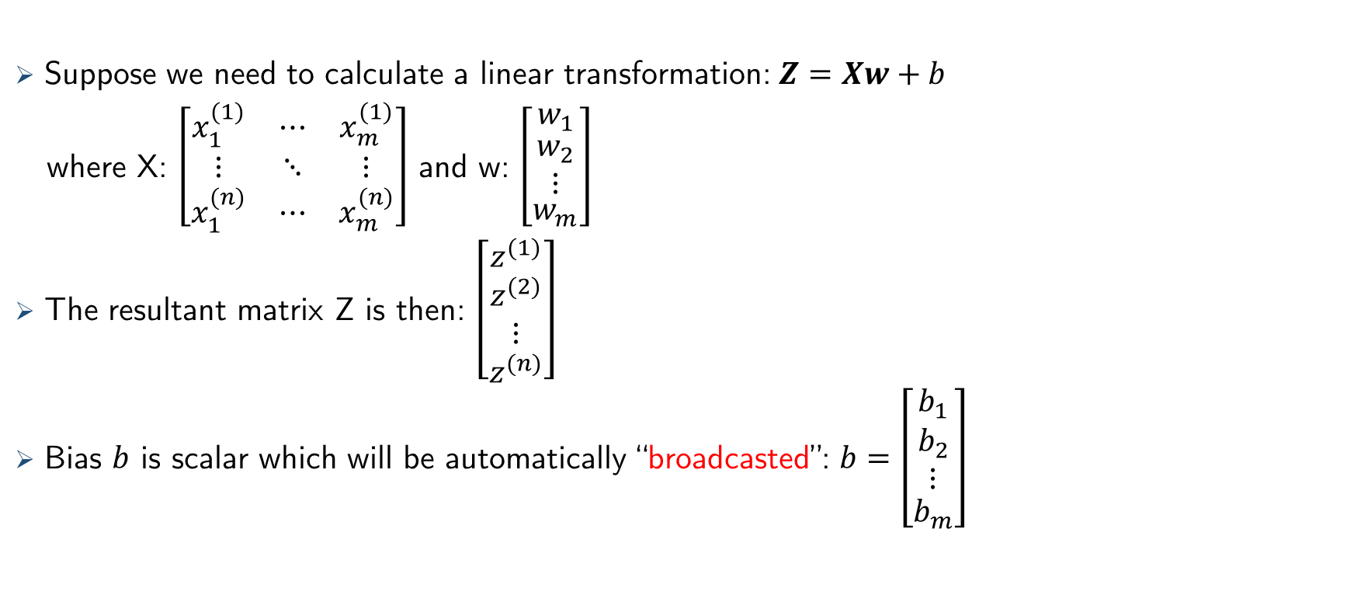
Vectorization
Suppose we need to calculate a linear transformation: $Z=Xw+b$
where X: $\left[\begin{matrix}x_{1}^{(1)} & ⋯ & x_{m}^{(1)} \\ ⋮ & ⋱ & ⋮ \\ x_{1}^{(n)} & ⋯ & x_{m}^{(n)}\end{matrix}\right]$ and w: $\left[\begin{matrix}w_{1} \\ \begin{matrix}w_{2} \\ ⋮\end{matrix} \\ w_{m}\end{matrix}\right]$
The resultant matrix Z is then: $\left[\begin{matrix}z^{(1)} \\ \begin{matrix}z^{(2)} \\ ⋮\end{matrix} \\ z^{(n)}\end{matrix}\right]$
Bias $b$ is scalar which will be automatically “broadcasted”: $b=\left[\begin{matrix}b_{1} \\ \begin{matrix}b_{2} \\ ⋮\end{matrix} \\ b_{m}\end{matrix}\right]$

Slide 14
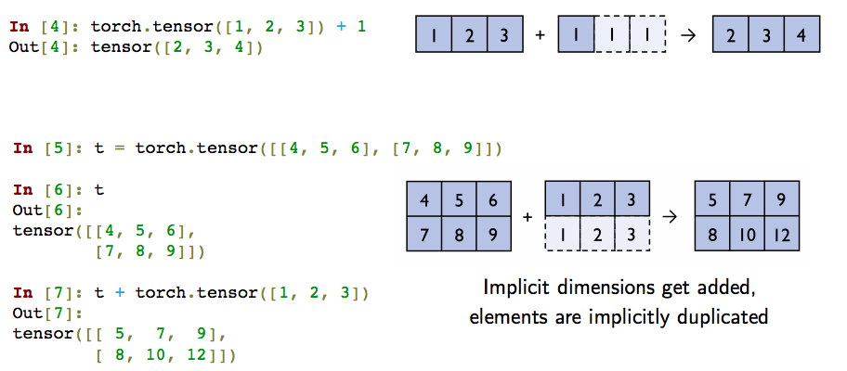
Broadcasting

Slide 15
Resources Used
STAT 479: Deep Learning by Sebastian Raschka
Pytorch.org
Machinelearningmastery.com by Jason Brownlee
Deeplearningbook by Ian Godfellow

